Slide 1

CS234 Operating Systems
DEPARTMENT OF COMPUTER SCIENCE AND ENGINEERING

Slide 2

Memory Management
In Uni_programming environment main memory is divided into two parts, one for kernel and other for program being executed currently.
In multiprogramming environment , user part of memory is further divided into multiple processes.
The task of subdivision is carried out by OS & is known as Memory management
Effective memory management is very important in multiprogramming environment.

Slide 3
Memory Management
  Subdividing memory to accommodate multiple processes
        Done by Memory Management of OS
Memory needs to be allocated to ensure a reasonable supply of ready processes to consume available processor time
OPERATING SYSTEMS
Notes:
MIT-WPU

Slide 4
Memory Management Requirements
Relocation
Protection
Sharing
Logical Organization
Physical Organization
OPERATING SYSTEMS

Slide 5
Memory Management Requirements
  Relocation
    Programmer does not know where the program will be placed in memory when it is executed
    While the program is executing, it may be swapped to disk and returned to main memory at a different location (relocated)
    Memory references must be translated in the code to actual physical memory address
OPERATING SYSTEMS

Slide 6
Memory Management Requirements
Protection
  Processes should not be able to reference memory locations in another process without permission
  Impossible to check absolute addresses at compile time
  Must be checked at run time
  Memory protection requirement must be satisfied by the processor (hardware) rather than the operating system (software)
    Operating system cannot anticipate all of the memory references a program will make
OPERATING SYSTEMS

Slide 7
Memory Management Requirements
Sharing
  Allow several processes to access the same portion of memory
  Better to allow each process access to the same copy of the program rather than have their own separate copy
OPERATING SYSTEMS

Slide 8
Memory Management Requirements
Logical Organization
  Programs are written in modules
  Modules can be written and compiled independently
  Different degrees of protection given to modules (read-only, execute-only)
  Share modules among processes
  Segmentation satisfies these requirements.
OPERATING SYSTEMS

Slide 9
Memory Management Requirements
Physical Organization
Computer memory is organized into at least two levels
  Main Memory: faster access, higher cost, volatile, no permanent storage, holds programs & data currently in use.
  Secondary memory: Slower , cheaper than main memory, not volatile, long term storage of programs & data
Organization of flow of information between main and secondary memory is major system concern
Individual programmer cannot take this responsibility
OPERATING SYSTEMS

Slide 10
Memory Management Requirements
Physical Organization
Main memory available for program and data may not be sufficient.
Overlaying technique can be used by programmer where various modules can be assigned to same region of memory & main program is responsible for switching in & out modules as and when needed. This leads to waste of time.
In multi programming environment programmer does not know at the time of coding, how much space is available for his/her program
OPERATING SYSTEMS

Slide 11
Memory Management Schemes
Memory Partitioning
      Fixed Partitioning
        Fixed size
        Variable size
      Dynamic Partitioning
Paging
Segmentation
Virtual Memory
OPERATING SYSTEMS

Slide 12
Memory Partitioning
Fixed Partitioning
OS occupies some fixed part of main memory. Rest of memory available for multiple processes.
This method divides main memory into regions with fixed boundaries.
    Make use of equal size partitions
    Make use of unequal size of partitions

Slide 13
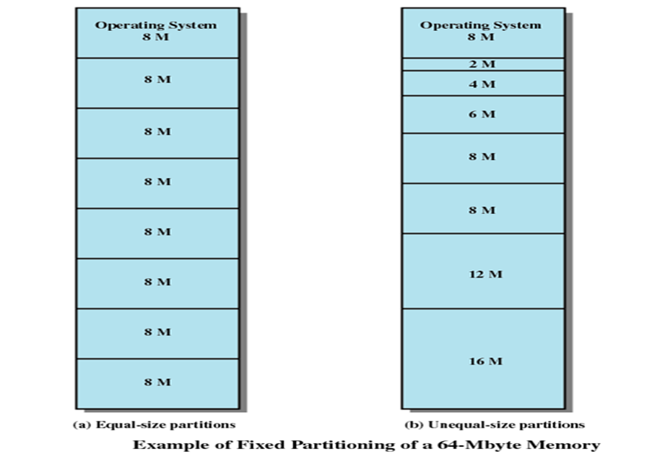
OPERATING SYSTEMS

Slide 14
Fixed size partitions
Any process whose size is less than or equal to the size of partition size can be loaded into any available portion
Difficulties:
  Program may be too big to fit into memory, so programmer has to design the programs with overlays
  Internal Fragmentation: Program may be very small, but still gets loaded into partition leaving lot of space free in that partition. Wasted space internal to a partition due to a fact that block of data loaded which is smaller than the size of partition, is known as Internal Fragmentation

Slide 15
Unequal sized partitions
Partitions are made but of unequal sizes.
As long as partition is available , process can be loaded into memory.
No particular portion is favored.
When no process is available for execution (all processes blocked), scheduler will take the decision to swap out a process to make space available for new process.

Slide 16
Scheduling Q strategies
Scheduling Q for each partition: Each partition will have its Q of Processes. Processes are always assigned in such a manner that there is minimum internal fragmentation.
Single Q for all processes: Provides a degree of flexibility to fixed partitioning.

Slide 17
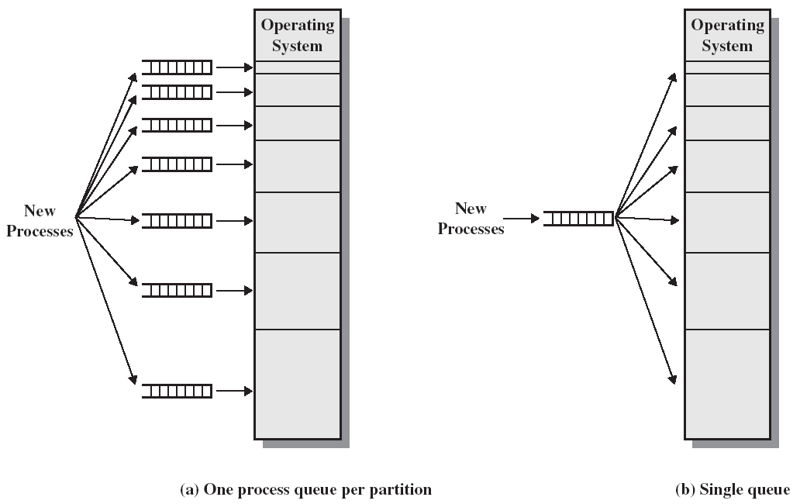
Memory Assignment for Fixed Partioning

Slide 18
Disadvantages of fixed partitions
No of partitions are decided at the time system generation. This limits to no. of active processes.
Main storage requirement of all jobs should be known well in advance
Small jobs will not use partition space efficiently, leading to internal fragmentation.
Fixed partitioning is almost unknown today
E.g. Multiprogramming Fixed Tasks (IBM mainframe OS-MFT)

Slide 19
Dynamic Partitioning
Partitions are of variable length and number
Process is allocated exactly as much memory as required
Eventually get holes in the memory. This is called external fragmentation
Must use compaction to shift processes so they are contiguous and all free memory is in one block

Slide 20
Example
Assume 64m, out of which 8m occupied by OS. Initially no processes in memory. Processes p1,p2,p3 arrive having sizes 20m,14m,18m respectively.
At some time all 3 processes are blocked and hole of 4m is created, which is not sufficient to accommodate a new process,p4 of size 8m.
P2 is swapped out and p4 occupies that space again creating a new hole of size 6m.
Suppose p4 is also blocked but p2 is ready.
Swap p1 & place p2 another hole of 6m created

Slide 21
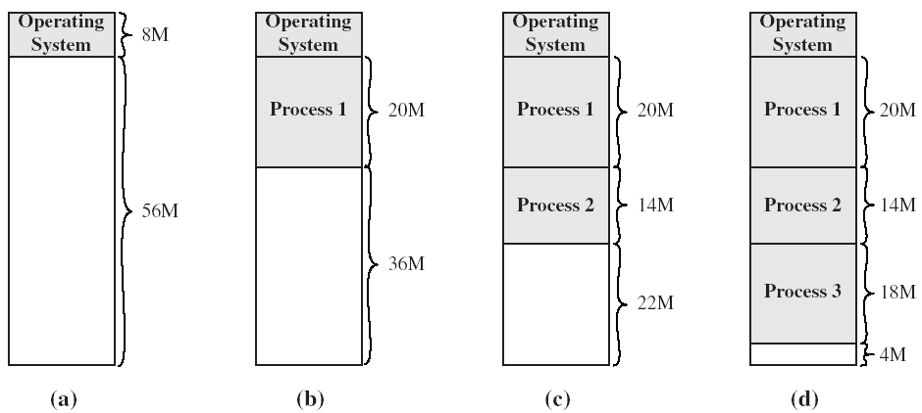
The Effect of Dynamic Partitioning

Slide 22
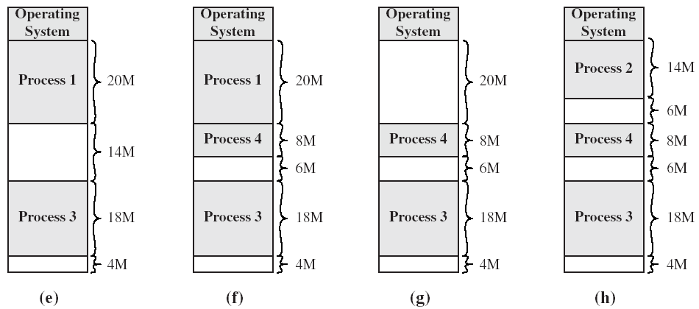
The Effect of Dynamic Partitioning

Slide 23
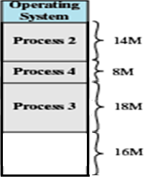
Dynamic partitioning contd
As time goes, memory becomes more & more fragmented.
External Fragmentation: Memory that is external to partitions becomes increasingly fragmented.
Compaction:
  OS shifts the processes, so that all free memory is available in one block.
  Time consuming process and wasteful of processor time
  Compaction requires dynamic relocation capability.

Slide 24
Dynamic Partitioning
Compaction is time consuming
Set of holes of various sizes, is created throughout memory.
When new process arrives, & needs memory, system searches for set of holes & finds a hole that is large enough to for that process.
If hole is too large, it is split into two parts, one part is allocated to process while, other is returned to a set of holes.
When process is swapped out/ terminated , it releases its block of memory to the set of holes.
If new hole is adjacent to other holes, adjacent holes are merged to form a new hole. OS checks whether any waiting process can fit into a combined hole.

Slide 25
Dynamic Partitioning Placement Algorithm
Operating system must decide which free block to allocate to a process.
Types:
  Best-fit algorithm
  First-fit algorithm
  Worst-fit algorithm
  Next-Fit algorithm
OPERATING SYSTEMS

Slide 26
Strategies for dynamic storage allocation
First Fit: Allocate the first hole that is big enough. Searching can begin at the start of set of holes.
Best Fit: Allocate the smallest hole that is big enough. Search entire list, unless the list is kept ordered by size.
Worst Fit: Allocate the largest hole. Search the entire list unless sorted by size.
Next Fit: Allocate the first hole that is big enough. Searching can begin where the previous search ended.

Slide 27
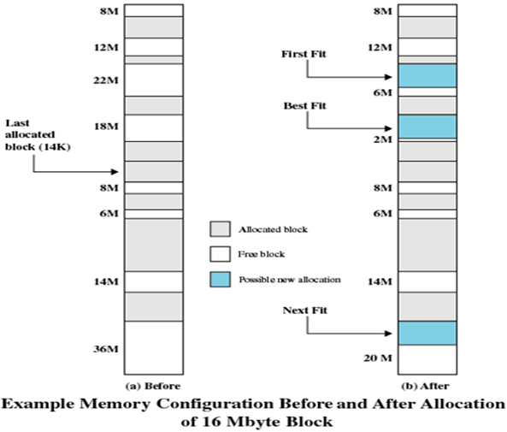
Dynamic Partitioning Placement Algorithm
New process of size 16M to be allocated
Best-fit algorithm
  Chooses the block that is closest in size to the request
  Worst performer overall
  Since smallest block is found for process, the smallest amount of fragmentation is left
  Memory compaction must be done more often
OPERATING SYSTEMS

Slide 28
Dynamic Partitioning Placement Algorithm
First-fit algorithm
  Scans memory from the beginning and chooses the first available block that is large enough
  Fastest
  May have many process loaded in the front end of memory that must be searched over when trying to find a free block
OPERATING SYSTEMS

Slide 29
Dynamic Partitioning Placement Algorithm
Worst-fit algorithm
Scan the entire list and find the holes having size >= size of process.
Amongst these holes select that hole having largest size
Worst Fit
OPERATING SYSTEMS

Slide 30
Example 1
Free memory holes of sizes 15K, 10K, 5K, 25K, 30K, 40K are available. The processes of size 12K, 2K, 25K, 20K are to be allocated. How processes are placed in first fit, best fit, worst fit?
OPERATING SYSTEMS

Slide 31

Holes
15
10
5
25
30
40
First Fit: Search from beginning
Search ends when you find the
Hole having size >= size of process
Processes
15-12=3
12
Modified list of holes - After assigning 15K hole to 12K process
03
10
5
25
30
40
3-2=1
2
Modified list of holes - After assigning 3K hole to 2K process
01
10
5
25
30
40
25-25=0
25
Modified list of holes - After assigning 25K hole to 25K process
01
10
5
30
40
20
30-20=10
Modified list of holes - After assigning 30K hole to 20K process
01
10
5
10
40
OPERATING SYSTEMS

Slide 32
Holes
15
10
5
25
30
40
Best Fit: Search entire list
Find the holes whose size >= size
of process. From these holes select
the hole of smallest size
Processes
15-12=3
12
Modified list of holes - After assigning 15K hole to 12K process
03
10
5
25
30
40
3-2=1
2
Modified list of holes - After assigning 3K hole to 2K process
01
10
5
25
30
40
25-25=0
25
Modified list of holes - After assigning 25K hole to 25K process
01
10
5
30
40
20
30-20=10
Modified list of holes - After assigning 30K hole to 20K process
01
10
5
10
40
OPERATING SYSTEMS

Slide 33
Holes
15
10
5
25
30
40
Worst Fit: Search entire list
Find the holes whose size >= size
of process. From these holes select
the hole of largest size
Processes
40-12=28
12
Modified list of holes - After assigning 40K hole to 12K process
15
10
5
25
30
28
30-2=28
2
Modified list of holes - After assigning 30K hole to 2K process
15
10
5
25
28
28
28-25=03
25
Modified list of holes - After assigning 28K hole to 25K process
15
10
5
25
03
28
20
28-20=08
Modified list of holes - After assigning 30K hole to 20K process
15
10
5
25
03
08
OPERATING SYSTEMS

Slide 34
Paging
Paging is a memory management scheme that permits the physical address space of a process to be noncontiguous.
Support for paging has been handled by hardware.
Recent designs have implemented paging by closely integrating H/W & OS, especially on 64 bit processors.

Slide 35
Paging
Partition memory into small equal-size chunks and divide each process into the same size chunks
The chunks of a process are called pages and chunks of memory are called frames
Operating system maintains a page table for each process
  contains the frame location for each page in the process
  memory address consist of a page number and offset within the page

Slide 36
Basic Method
Physical memory is broken into fixed sized blocks called frames. Logical memory is broken into blocks of same size called Pages.
0 0
1 1 2
3 2
3
Page Table
Physical Memory
Page 0
Page 1
Page 2
Page 3
1
4
3
7
0
1
2
3
4
5
6
7
Page 0 stored at frame 1
Page 1 stored at frame 4
Page 0
Total
8 frames
Page 2 stored at frame 3
Page 3 stored at frame 7
Page 2
Page 1
Logical Memory
Index of page Table is page no, value is frame
Page 3

Slide 37
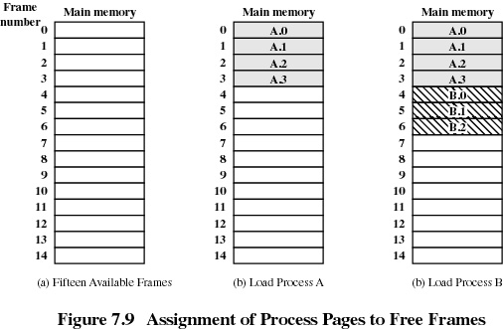

Slide 38
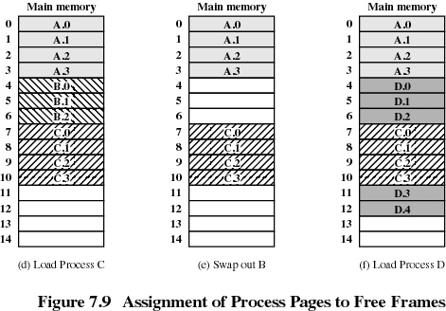

Slide 39
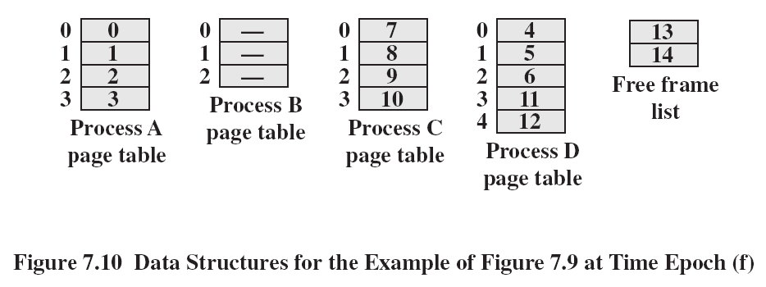
Page Tables

Slide 40
Paging: Description
Page size defined by H/W, typically power of 2. Selection of power of 2 as a page size makes the translation of logical address into page no. and page offset easy.
No external fragmentation.
Any free frame can be allocated to a process that needs it.
Internal fragmentation may exist.

Slide 41
Example: Internal fragmentation in paging
Process size 72,766 bytes
Page size 2048 bytes
Find the size of internal fragmentation

Slide 42
Ex. Internal fragmentation in paging
Process size 72,766 bytes
Page size 2048 bytes
It will require 36 frames out of which 35 will be fully occupied, while last one giving rise to internal fragmentation of size 962
72766 / 2048 = 35.53
2048 * 35 = 71680 35 total occupied pages
72,767 – 71,680 = 1086 remaining bytes of process
36th page: 2048 – 1086 = 962
Process size – remaining process = int. fragmentation

Slide 43
Issues in page size
If process size is independent of page size, we expect internal fragmentation to average one half page per process.
Small page sizes are desirable, but more overhead involved in each table entry which can be reduced if size of page increases.
Page size 4kb to 8kb
Each table entry is usually 4 bytes long, but that size can vary.

Slide 44
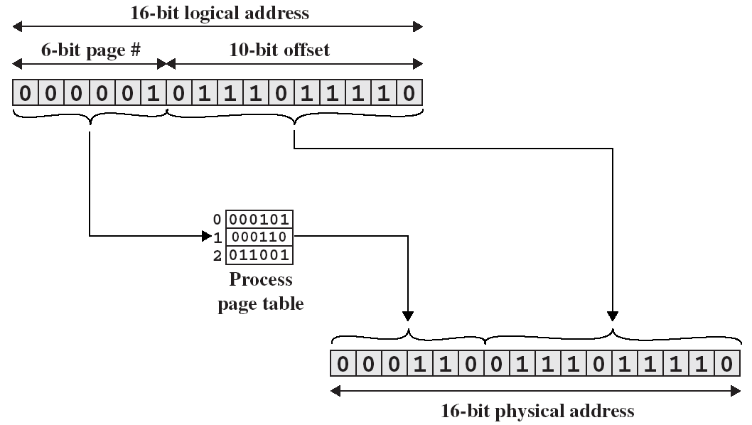
Ex-Page Translation

Slide 45
Paging Contd.
Paging separates user’s view of memory & actual memory.
User feels logical memory as one contiguous space where in only his/her program resides.
In physical memory user’s program is scattered along with other programs.
Address translation H/W maps user’s view to physical address and is hidden from user & controlled by OS.
OS must be aware of allocation details of physical memory.
OS maintains frame table which stores information about total, allocated and available frames.
OS maintains a copy of page table for each process, which is used to translate logical address to physical address, also used by dispatcher to define H/W page table to assign process to CPU
Paging increases context switch time.

Slide 46
Segmentation
Memory-management scheme that supports user view of memory.
A program is a collection of segments. A segment is a logical unit such as:
main program,
procedure, function,
method, object,
local variables, global variables,
common block,
stack,
symbol table, arrays

Slide 47

User’s View of a Program

Slide 48
Logical View of Segmentation
1
1
4
2
3
2
4
3
user space
physical memory space

Slide 49
Segmentation Architecture
Logical address consists of a two tuple:
<segment-number, offset>,
Segment table – maps two-dimensional physical addresses; each table entry has:
  base – contains the starting physical address where the segments reside in memory.
  limit – specifies the length of the segment.
Segment-table base register (STBR) points to the segment table’s location in memory.
Segment-table length register (STLR) indicates number of segments used by a program;
segment number s is legal if s < STLR.

Slide 50

Segmentation Hardware

Slide 51

Example of Segmentation

Slide 52
Example- Segmentation
Segment No | Segment Base Address | Segment Length
0 | 660 | 248
1 | 1752 | 422
2 | 222 | 198
3 | 996 | 604
For each of the following logical addresses, determine
Physical address or indicate segment fault
0,198
2,156
1,530
3,444
0,222

Slide 53
Segmentation
All segments of all programs do not have to be of the same length
There is a maximum segment length
Addressing consist of two parts - a segment number and an offset
Since segments are not equal, segmentation is similar to dynamic partitioning

Slide 54
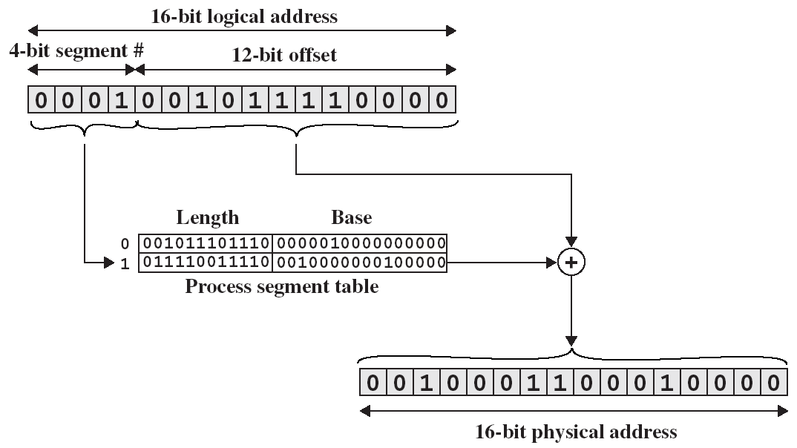
Segment Translation

Slide 55
Paging vs Segmentation
 | Paging | Segmentation
Basic | Page is fixed size block | Segment is of variable size
Fragmentation | Paging may lead to Internal Fragmentation | Segmentation may lead to External Fragmentation
Address | CPU divides the specified address into page no and offset | User specifies the address as segment no and offset
Size | Page size decided by hardware | Segment size specified by user
Table | Page table contains the base address of each table | Segment table contains segment no , base address and length
2010INT.8.<number>
2003/2

Slide 56
Virtual Memory
OPERATING SYSTEMS

Slide 57
Types of Memory
Real memory
  Main memory
Virtual memory
  Memory on disk
  Allows for effective multiprogramming and relieves the user of tight constraints of main memory
OPERATING SYSTEMS

Slide 58
Hardware and Control Structures
Memory references are dynamically translated into physical addresses at run time
  A process may be swapped in and out of main memory such that it occupies different regions
A process may be broken up into pieces that do not need to located contiguously in main memory
All pieces of a process do not need to be loaded in main memory during execution
OPERATING SYSTEMS

Slide 59
Execution of a Program
Operating system brings into main memory a few pieces of the program
Resident set - portion of process that is in main memory
An interrupt is generated when an address is needed and it is not in main memory
Operating system places the process in a blocking state
OPERATING SYSTEMS

Slide 60
Continued…
Piece of process that contains the logical address is brought into main memory
  Operating system issues a disk I/O Read request
  Another process is dispatched to run while the disk I/O takes place
  An interrupt is issued when disk I/O complete which causes the operating system to place the affected process in the Ready state
OPERATING SYSTEMS

Slide 61
Advantages of Breaking up a Process
More processes may be maintained in main memory
  Only load in some of the pieces of each process
  With so many processes in main memory, it is very likely a process will be in the Ready state at any particular time
A process may be larger than all of main memory
OPERATING SYSTEMS

Slide 62
Valid-Invalid Bit
During address translation, CPU
splits address in two parts, Page
no and offset, page no is used as
Index into Page Table. If valid–invalid
bit in page table entry is 0, it
means page is not in main memory
,which is page fault , or possibly
illegal reference
With each page table entry a valid–invalid bit is associated
(1 ⇒ in-memory (and a “legal” page),
0 ⇒ not-in-memory - legal but on disk or illegal)
… distinguish from invalid (illegal) reference -
Example of a page table snapshot.
Frame #
valid-invalid bit
0
1
1
1
2
1
3
1
4
0
5
...
0
n-1
0
page table

Slide 63

Page Table When Some Pages Are Not in Main Memory and some ouside process space
Meaning of valid bit:
valid means page is both in memory
and legal (in address space of
process)
invalid means that page is either
outside of the address space of the
process (illegal), OR a legal address
but not currently resident in memory
(a page fault - most common)
NOTE: ref to pages 6 & 7 are illegal.
refs to pages 3 & 4 are page faults
both cases marked invalid.

Slide 64

Steps in Handling a Page Fault
Page fault but No page replacement
needed in this case -
a free frame was found.

Slide 65
Page Fault: A page fault occurs when a program attempts to access data or code that is in its address space, but is not available in the RAM.
During address translation, CPU splits address in two parts, Page no and offset,
page no is used as Index into Page Table. If valid–invalid bit in page table entry is 0,
it means page is not in main memory ,which is page fault , or possibly illegal reference
For each process no. of frames are assigned. OS maintains list of free frames for
each process. When page fault occurs, page is brought in main memory. If free frame
is available page is placed in the free frame and valid bit for that page is made as 1.
But if free frame is not available, page replacement takes place. From existing pages
Page is selected for replacement.
OPERATING SYSTEMS

Slide 66
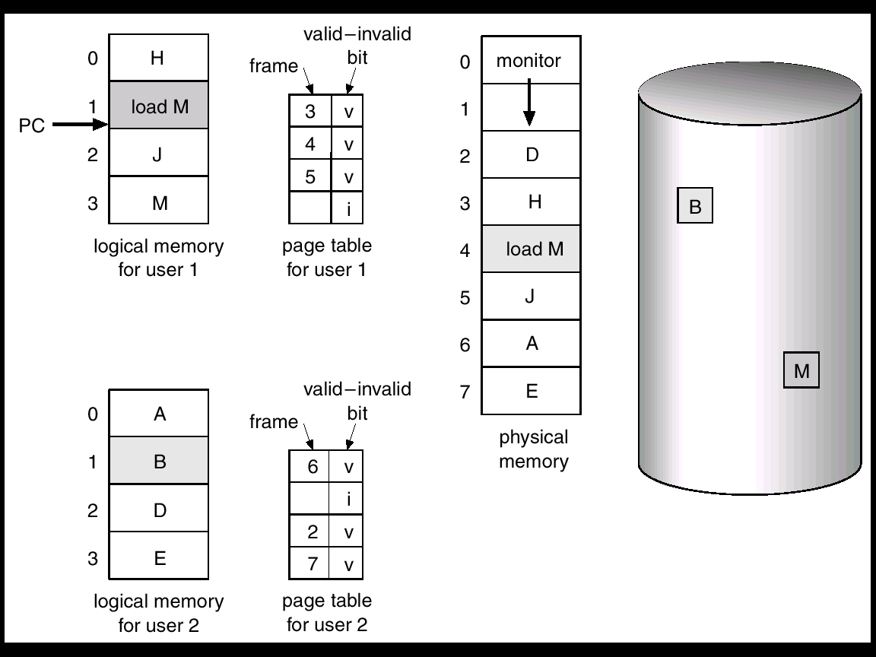
Need For Page Replacement
3 frames per process
Page 3 of user process 1 not in
Main memory
Page 1 of user process 2 not in
Main memory
User Process 2 requires page 1, invalid
Bit, not in memory.
Memory full – Free frame
List is empty … must free up
Space: page replacement
page fault ==>
B needed, but not in memory, also
Page replacement

Slide 67
After Page Replacement
Page 2 is selected for replacement, it was there in frame 2. After replacement in frame 2, Page 1 will reside. Page 1 becomes valid and page 2 is invalid.
Physical Memory
Page table
For process 1
0
Kernel
H
3 V
Kernel
Three frames per
process
0
0
1
1
Load M
1
4 V
2
B
Process 1
Logical memory
2
J
2
5 V
3
H
M
I
Load M
D
3
3
4
5
J
M
Process 2
Logical memory
0
A
0
6 V
6
A
1
B
1
2 V
2
I
7
E
2
D
3
7 V
B brought in
D swapped out
3
E
Page table
For process 2

Slide 68
Page Replacement and Modify Bit in Page Table
If free frame is not available, select the page to be swapped out.
Modify bit in page table indicates if the page has been altered since it was last loaded into main memory
If no change has been made, the page does not have to be written to the disk when it needs to be swapped out
OPERATING SYSTEMS

Slide 69
Basic Page fault handling
Find the location of the desired page on disk.
Find a free frame:
- If there is a free frame, use it.
- If there is no free frame, use a page replacement algorithm to select a victim frame … this is the likelihood.
Read the desired page into the frame. Update the page and frame tables.
If the “victim” page frame is modified it will have to paged out to the disk.
Restart the process (process was blocked during page fault processing).

Slide 70
Fetch Policy
Determines when a page should be brought into memory
Demand paging only brings pages into main memory when a reference is made to a location on the page
  Many page faults when process first started
Prepaging brings in more pages than needed
  More efficient to bring in pages that reside contiguously on the disk
  Ineffective as most of the extra pages that are brought in are not referenced.
OPERATING SYSTEMS

Slide 71
Replacement Policy
Frame Locking
  Associate a lock bit with each frame
  If frame is locked, it may not be replaced
  Example:
    Kernel of the operating system
    Control structures
    I/O buffers
    Time-critical main memory frames
OPERATING SYSTEMS

Slide 72
Thrashing
Swapping out a piece of a process just before that piece is needed
The processor spends most of its time swapping pieces rather than executing user instructions
A process is busy swapping pages in and out most of the time - very little time spent on productive work - most time spent doing paging.
OPERATING SYSTEMS

Slide 73
Basic Replacement Algorithms
First In First Out (FIFO)
Optimal Policy
Least Recently Used (LRU)
OPERATING SYSTEMS

Slide 74
First-in, first-out (FIFO)
Treats page frames allocated to a process as a circular buffer
Pages are removed in round-robin style
Simplest replacement policy to implement
Page that has been in memory the longest is replaced
These pages may be needed again very soon
OPERATING SYSTEMS

Slide 75
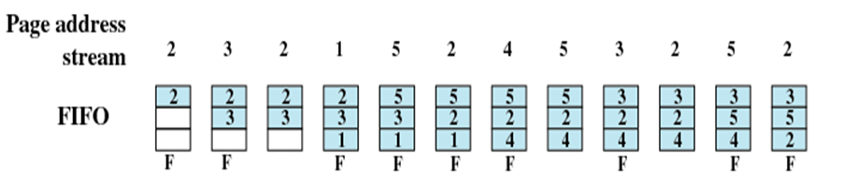
Example: FIFO, no of frames 3
Total page faults = 9
OPERATING SYSTEMS

Slide 76
Optimal policy
Selects for replacement that page for which the time to the next reference is the longest
Impossible to have perfect knowledge of future events
OPERATING SYSTEMS

Slide 77
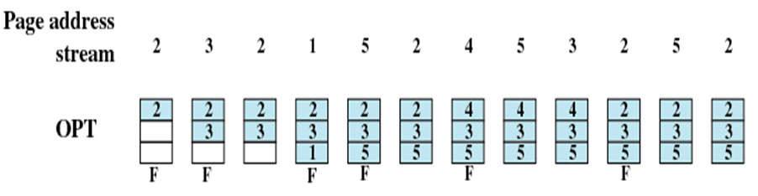
Example: Optimal policy, no of frames 3
Total page faults = 6
OPERATING SYSTEMS

Slide 78
Least Recently Used (LRU)
Replaces the page that has not been referenced for the longest time
By the principle of locality, this should be the page least likely to be referenced in the near future
Each page could be tagged with the time of last reference. This would require a great deal of overhead
OPERATING SYSTEMS

Slide 79
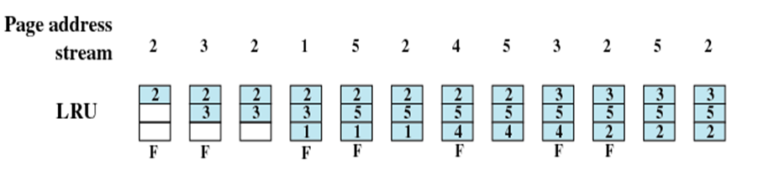
Example: LRU, no of frames 3
Total page faults = 7
OPERATING SYSTEMS

Slide 80
Belady’s Anomaly
Increasing number of frames should decrease number of faults.
In some algorithms it is observed that if number of frames are increased, page faults are increased.
This is called as Belady’s anomaly.
APPLIED OPERATING SYSTEM CONCEPTS

Slide 81

FIFO Illustrating Belady’s Anamoly
APPLIED OPERATING SYSTEM CONCEPTS

Slide 82
Translation Lookaside Buffer
Each virtual memory reference can cause two physical memory accesses
  One to fetch the page table
  One to fetch the data
To overcome this problem a high-speed cache is set up for page table entries
  Called a Translation Lookaside Buffer (TLB)
  Contains page table entries that have been most recently used

Slide 83
Translation Lookaside Buffer
Given a virtual address, processor examines the TLB
If page table entry is present (TLB hit), the frame number is retrieved and the real address is formed
If page table entry is not found in the TLB (TLB miss), the page number is used to index the process page table

Slide 84
Translation Lookaside Buffer
First checks if page is already in main memory
  If not in main memory a page fault is issued
The TLB is updated to include the new page entry

Slide 85
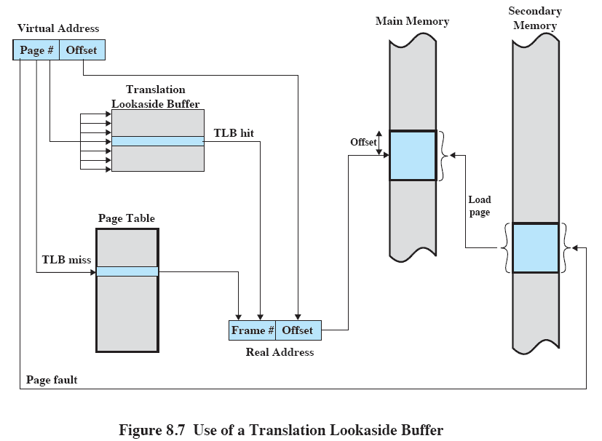
Translation Lookaside Buffer

Slide 86
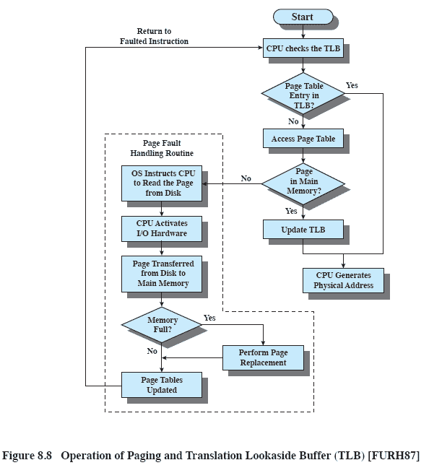
Translation Lookaside Buffer

Slide 87
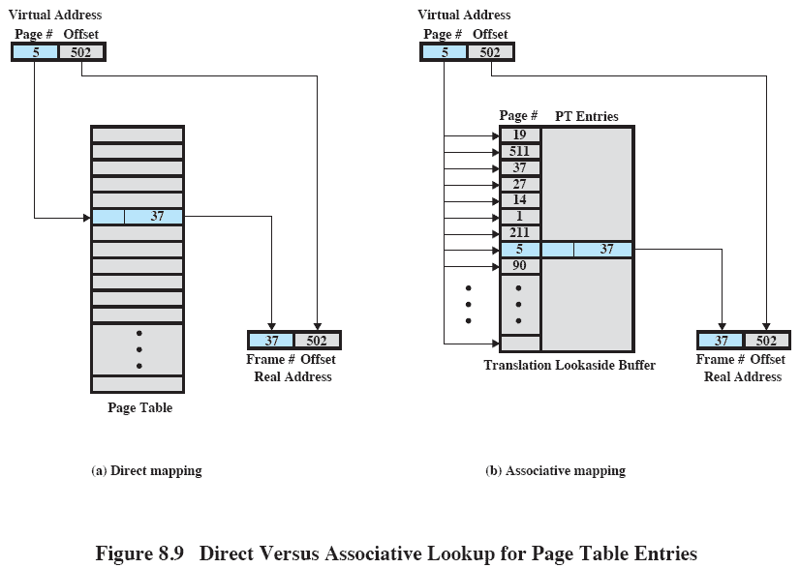
Translation Lookaside Buffer

Slide 88
END
OPERATING SYSTEMS

